Slide 1
UML Sequence Diagram
Understanding Interaction Between System Components
TA/Abdelrahman Hanfi

Slide 2

UML
The Unified Modeling Language (UML) is a standardized, general-purpose visual modeling language used to specify, visualize, construct, and document software systems, business processes, and structural designs

Slide 3
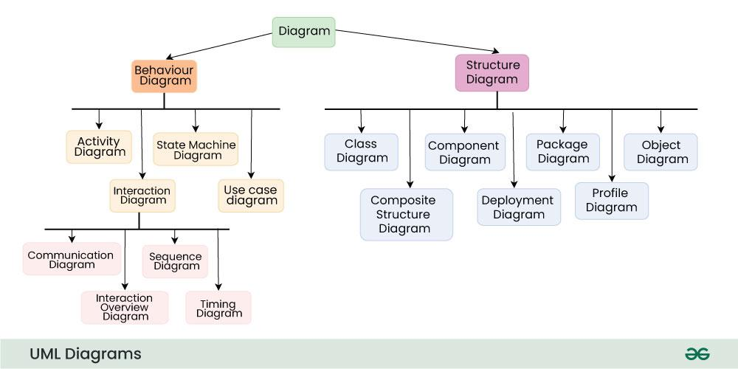

Slide 4
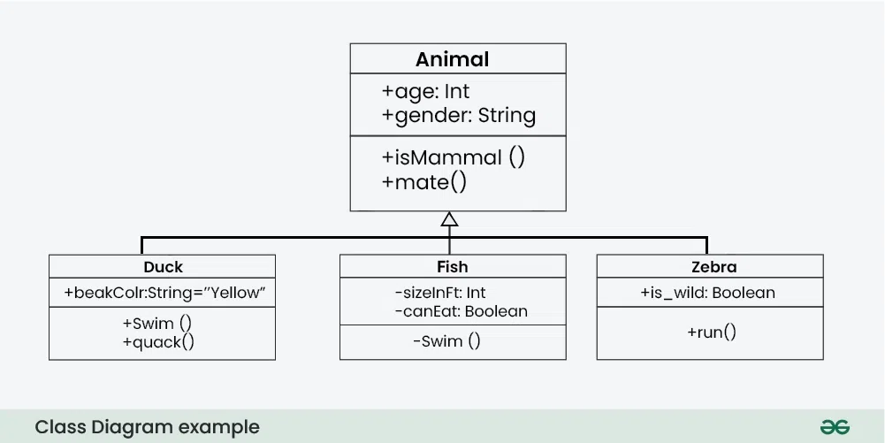
Structural diagrams
which map the static, physical, or logical components of a system (e.g., classes, objects, deployment)

Slide 5
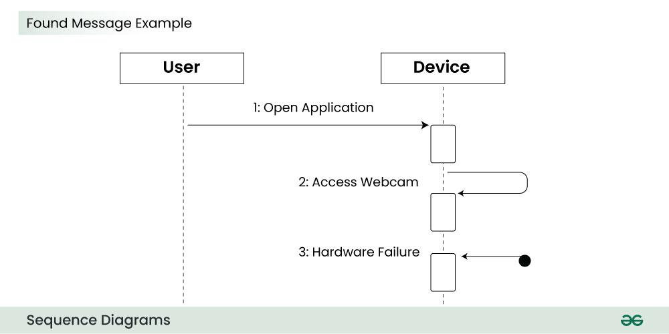
Behavioral diagrams
which represent the dynamic, changing interactions, processes, and workflows over time (e.g., activity, sequence, state machine)

Slide 6
Sequence Diagram
The Problem: An Activity Diagram tells us what happens (the logic), but it doesn’t tell us who does it.
An activity diagram starts from an initial point and ends at a final point, showing different decision paths along the way.
The Solution: The Sequence Diagram.
The Goal: Documenting how Angular components, services, and APIs communicate over time.

Slide 7
What is a Sequence Diagram?
A type of UML (Unified Modeling Language) diagram
Shows how objects interact in a particular sequence
Focuses on time order of messages
Used to model system behavior dynamically

Slide 8
Why Use Sequence Diagrams?
Visualize system interactions clearly
Help in designing and debugging systems
Improve communication between developers
Useful in documenting workflows

Slide 9
Use cases of Sequence Diagrams
Here are some use cases of sequence diagram:
System Behavior Visualization: Sequence diagrams show how objects, components, or actors interact over time, providing a clear view of the flow of messages and events in a scenario.
Software Design and Architecture: They help developers and architects plan and understand how system components work together, serving as a blueprint for system behavior.
Communication and Collaboration: Sequence diagrams make complex interactions easy to understand, helping teams and stakeholders communicate and collaborate effectively.
Requirements Clarification: They clarify how system components or external entities should interact, ensuring everyone has a common understanding of system behavior.
Debugging and Troubleshooting: Developers use sequence diagrams to track the order and timing of messages, helping identify and fix issues in system interactions.

Slide 10
Basic Components
Actors → external users or systems
Objects → system components
Lifelines → represent existence over time
Messages → communication between objects

Slide 11
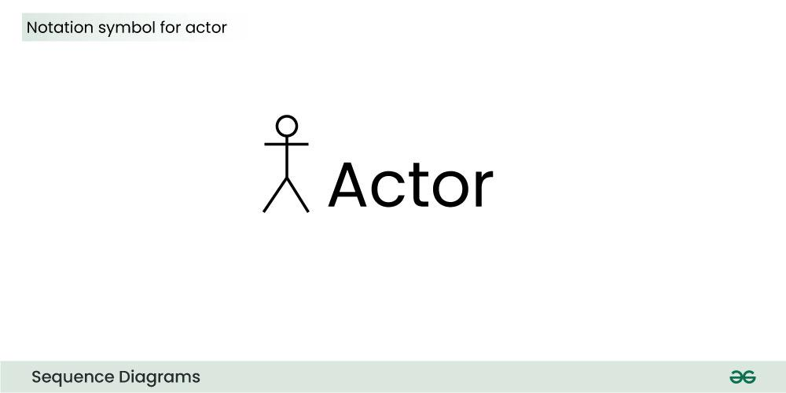

Slide 12
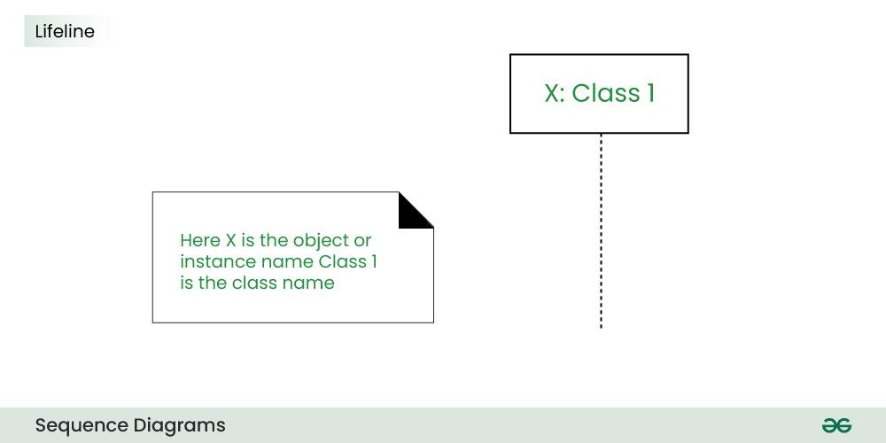

Slide 13
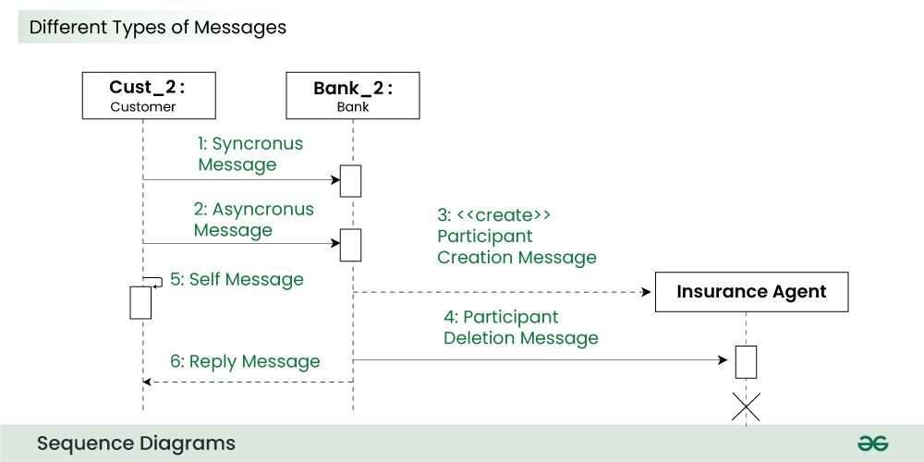

Slide 14
Types of messages
1. Synchronous messages
A synchronous message waits for a reply before the interaction can move forward. The sender waits until the receiver has completed the processing of the message. The caller continues only when it knows that the receiver has processed the previous message i.e. it receives a reply message.
A large number of calls in object oriented programming are synchronous.
We use a solid arrow head to represent a synchronous message.

Slide 15
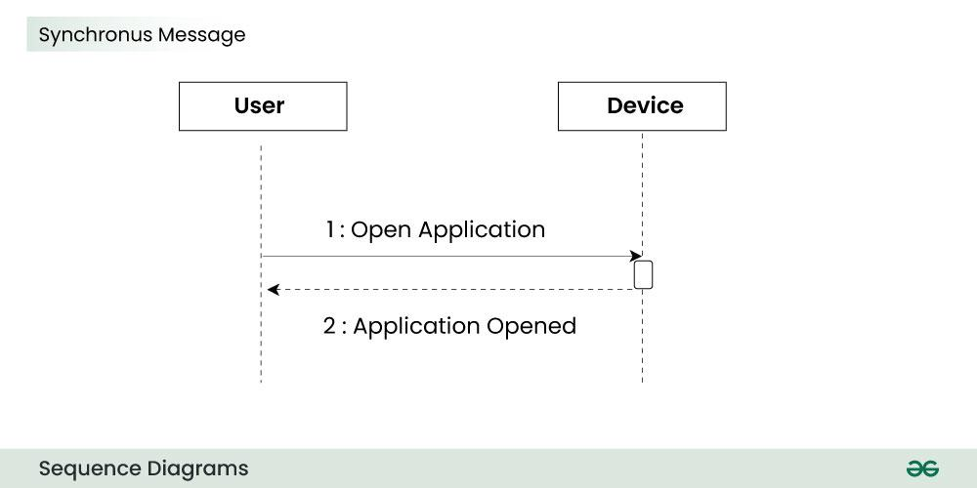
Types of messages

Slide 16
Types of messages
2. Asynchronous Messages
An asynchronous message does not wait for a reply from the receiver. The interaction moves forward irrespective of the receiver processing the previous message or not. We use a lined arrow head to represent an asynchronous message.

Slide 17
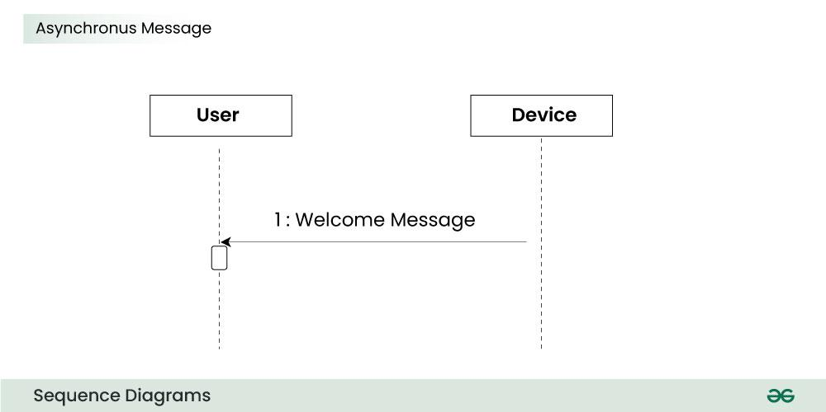
Types of messages

Slide 18
Types of messages
4. Create message
We use a Create message to instantiate a new object in the sequence diagram. There are situations when a particular message call requires the creation of an object. It is represented with a dotted arrow and create word labelled on it to specify that it is the create Message symbol.
For example:
The creation of a new order on a e-commerce website would require a new object of Order class to be created.

Slide 19
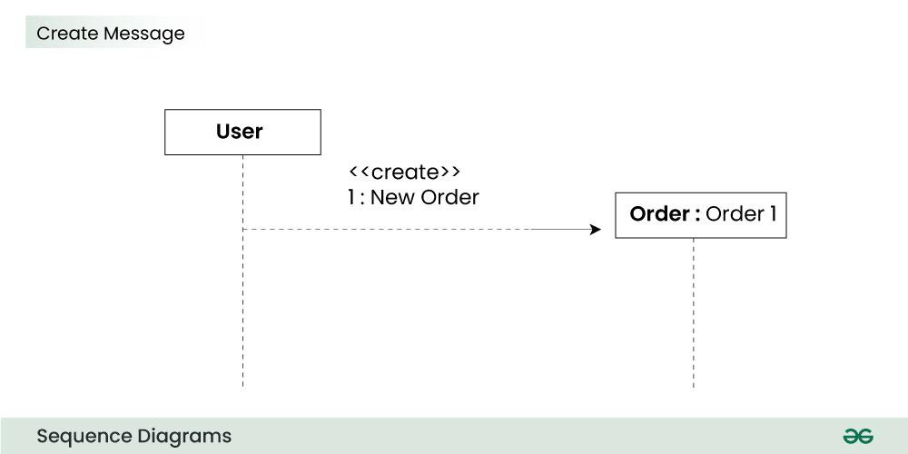
Types of messages

Slide 20
Types of messages
5. Delete Message
We use a Delete Message to delete an object. When an object is deallocated memory or is destroyed within the system we use the Delete Message symbol. It destroys the occurrence of the object in the system. It is represented by an arrow terminating with a x.
For example:
In the scenario below when the order is received by the user, the object of order class can be destroyed.

Slide 21
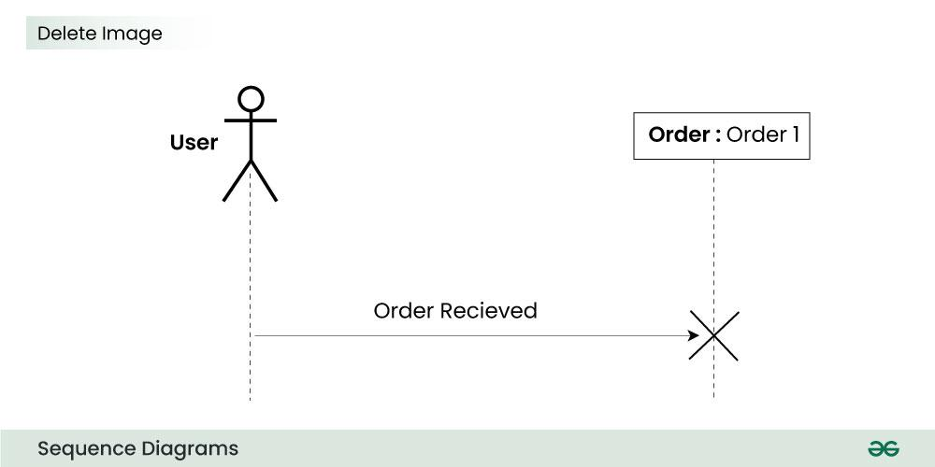
Types of messages

Slide 22
Types of messages
6. Self Message
Certain scenarios might arise where the object needs to send a message to itself. Such messages are called Self Messages and are represented with a U shaped arrow.
For example:
Consider a scenario where the device wants to access its webcam. Such a scenario is represented using a self message.

Slide 23
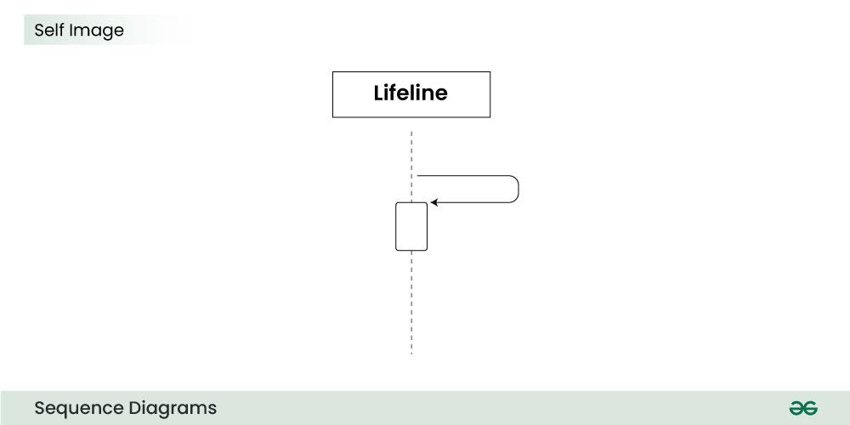
Types of messages

Slide 24
Types of messages
7. Reply Message
Reply messages are used to show the message being sent from the receiver to the sender. We represent a return/reply message using an open arrow head with a dotted line. The interaction moves forward only when a reply message is sent by the receiver.

Slide 25
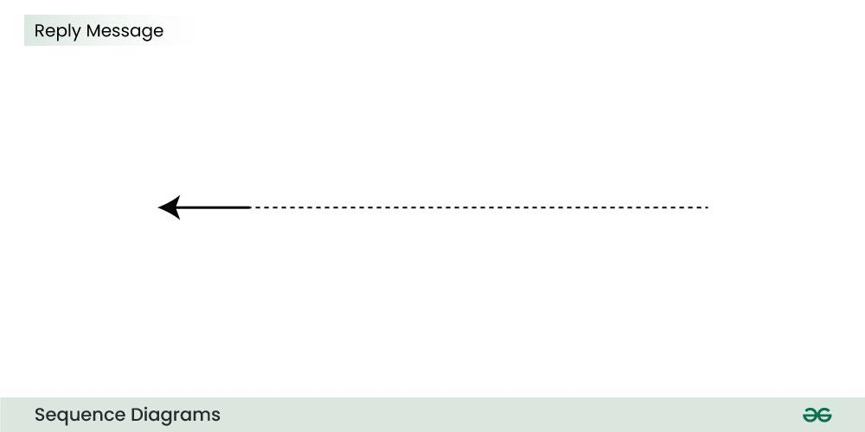
Types of messages

Slide 26
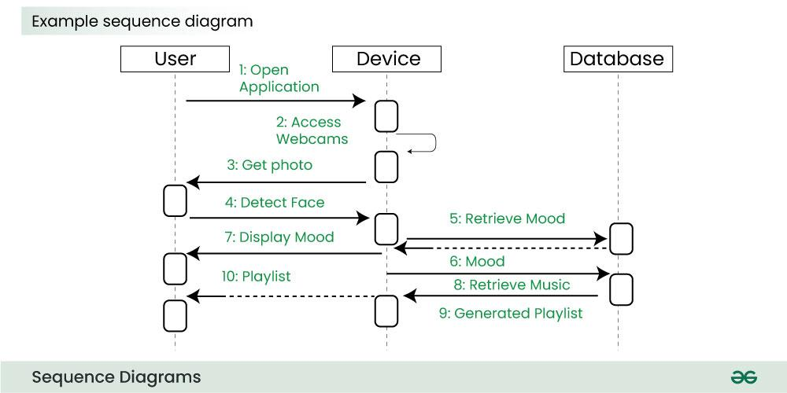
Example

Slide 27
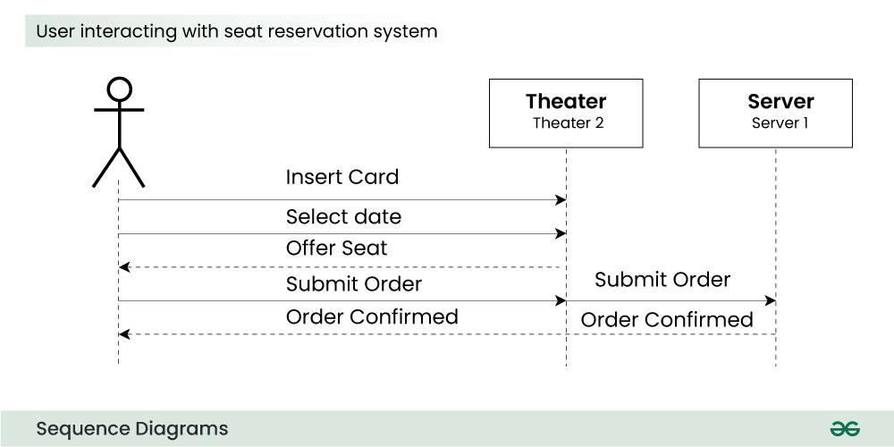
Example

Slide 28
Question
A customer uses an online food ordering application to place an order. First, the customer opens the app and selects a restaurant. The system then retrieves the restaurant’s menu from the database and displays it to the customer. After browsing the menu, the customer selects the desired items and places an order. The system processes this request and sends the order details to the restaurant. The restaurant reviews the order and sends a confirmation back to the system. Following this, the system initiates a payment request through a payment gateway. Once the payment is successfully completed, the system confirms the order and proceeds to arrange its delivery.
Question: Draw a sequence diagram that represents this scenario, clearly identifying the actors, system components, and the messages exchanged between them in the correct order.

Slide 29
Summary
Sequence diagrams model interaction over time
Essential for system design and analysis
Helps in understanding real-world workflows

